Slide 1
Summarizing
Notes:
Say: Today we’re going to work on the comprehension strategy of summarizing.

Slide 2
summary to summarize summarizing
brief summary
quick summary
provide a summary
to summarize the information
summarize the article
briefly summarize
Notes:
Say: This is how you most commonly hear this word used. You might be asked to provide a brief summary (have students repeat), quick summary (students repeat), provide a summary (students repeat), to summarize the information (students repeat), to summarize the article (students repeat), or to briefly summarize (students repeat).

Slide 3
Rate your Knowledge
1. I don’t know it.
2. I’ve heard it, but I don’t know the meaning.
3. I can use it in a sentence.
4. I can teach it to the class.
Notes:
Say: How well do you know this word?
Do: Read the ranking system, have students hold up a finger that represents their knowledge.
Say: Okay, I see some different numbers let’s get everyone to a 4!

Slide 4
Definition of a Summary
To give the main points, or ideas, without the details; to give a short account—the who, what, when, where (sometimes why).
Notes:
Say: A summary is… (read definition to students, then read it again using choral cloze; leave specific words out while they chime in as a group).

Slide 5
Example: What did you do last night?
Who: my mom, my dad, and I
What: went to dinner
Where: Carl's Jr.
When: 8:00 p.m.
At 8:00 p.m., I went to dinner with my mom and dad at Carl’s Jr.
Notes:
Say: Here is a response to a question. We have the main points, covered by who, what, where, when. When you put that together you get a short account.

Slide 6
Non-example: What did you do last night?
I got home from school, and I felt hungry, but my mom told me not to eat because we were going to go out to dinner a little later when my dad got home. He works for UPS delivering, so sometimes we don’t know when he’ll be home. He got home at 7:45, so we were able to make it Carl Jr.’s by 8:00. I had a hamburger and some fries. They were delicious.
Notes:
Say: Here is a response to a question. We have the main points, covered by who, what, where, when, but we have a lot of additional minor details, so this is not a summary. Let’s look at one more example.

Slide 7
Visualize the Image
Who: A dog
What: Lying down
When: Daytime
Where: In Arkansas
My one sentence summary:
In Arkansas, during the day there is a dog lying down.
Notes:
Say: Here is a brief summary of an image using the keywords who, what, when, and where, to ensure that the main ideas are included. Please try to visualize the image based on the following summary.
Do: Read slide and pause for 1-2 minutes.
Say: Does everyone see the picture in your mind?
Do: Change to next slide when students are ready.

Slide 8
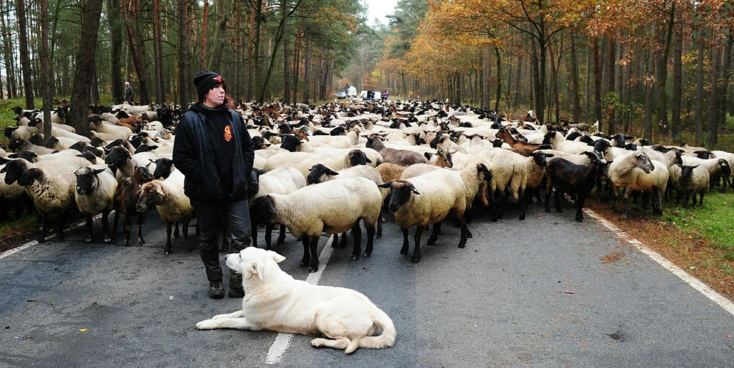
Is this what you pictured?
In Arkansas, during the day there is a dog lying down.
Notes:
Say: Is this what you pictured? (Students respond No!) Why not?
Possible student responses: We don’t know if this is Arkansas or not; the dog is not the main point of the picture; you left out information.

Slide 9
Let’s fix this summary!
Who:
What:
When:
Where:
Man, dog, and a
herd of sheep.
The man is standing and the dog is lying down next to him, in front of a herd of sheep
Daytime, present
day
In the woods, in the middle of the road.
Notes:
Say: Let’s fix this summary! What are the words I should use to ensure that I get the main points? (Students respond who, what, when, where). Excellent. So, I’m going to write those down to guide me. When we’re summarizing, we’re providing the main ideas, and it should be literal information that we can point to. We aren’t making inferences yet, so for example, I said Arkansas, but I can’t point to that, and I don’t know that for sure. The literal information that I can point to is in the woods. (Slide is animated)
When we look at “who” is in the picture we want to list people as well as animals, if there are no people or animals then we may consider an inanimate object as the “who” if that is the main focal point of the picture. Think about “who” as the main person, animal, or thing. In this picture I see (point to each one as you say) a man, a dog, and a herd of sheep, so notice when I saw a lot of something- like sheep I tried to group it together: a herd of sheep. (click animation).
When we identify the what, we want to think about what each one of the “who’s” is doing. (Point to each as you say) The man is standing and the dog is laying down next to him, in front of a herd of sheep.
The when, or time, can be very concrete. It’s daytime, but that might not always be relevant, sometimes we’re talking about a more global time, such as the past or present. When we say present, it could be considered modern times– what in this picture let’s you know it’s in the present? (his clothes, the road). Yes, so we will say daytime, and present day. (click animation)
Finally, where? Well (point) in the woods, but if I just aid that I’m missing something very important, If I just saw a man and dog in front of a herd of sheep in the middle of the woods it wouldn’t be that important, but what is unique about this? (point to the road). They are in the middle of the road! So, my where is in the woods, in the middle of the road. (Click animation).
Wonderful. Now that we have the main ideas or main points let’s put it in a sentence. Sometimes a summary includes why, but we don’t know why we would have to make an inference. We will talk more about that when we begin our warm-ups.

Slide 10
Putting our summary into a sentence
Who:
What:
When:
Where:
Man, dog, and a
herd of sheep.
During the day,
in the woods,
The man is standing and the dog is lying down next to him, in front of a herd of sheep
a man is standing with a dog in the middle of the road in front of a herd of sheep.
Daytime, present
day
In the woods, in the middle of the road.
Notes:
Say: Sometimes I will ask you to leave your summary in this form. Especially when you are reporting out orally, the keywords help us to listen for key information, so I might ask you to say, “Who: man, dog, and a herd of sheep.” Then look at us for confirmation to make sure we processed what you said, then you could continue to “what...” and so on.
Other times, I will ask you to put it in writing into 1-2 sentences. When you do this, it is helpful to begin with where or when, and as you include information cross it off so you make sure you got everything. Also, here you can refine what is most important, so for example if I start with the time- I realize that daytime is more important that the fact that it is present day, so I would say:
(click animation) During the day, (click animation), so I’m keeping the information daytime, but changing the wording to fit the beginning of a sentence. Next, I can move to where,
in the woods (click animation 2x). Now I’m going to combine the who’s, what they’re doing, and the remaining where (click animation): a man is standing with a dog in the middle of the road in front of a herd of sheep. Notice I changed the order, but I included all of the information– (point to the following information in the sentence and in the notes to show students everything is included). I did leave the fact that the dog was lying down out, but I decided it wasn’t that important. What do you all think? Based off of this summary, what do you picture? Is it something like this? (change slides).

Slide 11
Is this what you pictured?
During the day, in the woods, a man is standing with a dog in the middle of the road in front of a herd of sheep.
Notes:
Say: Is this what you pictured? Now let’s try one together.

Slide 12
Warm-Ups
From now on, when you see the word summarize, or know that you will be doing a summary, the first thing I want you to do is write down: who, what, when, where.
Let’s practice with a picture!
Please Note: You can fill out the information in any order, but it is often easiest to save the “what” for last.
Notes:
Do: Pass out the warm-ups handout. And complete with the students. You just modeled and now you are doing one together, so this is the gradual release of responsibility.

Slide 13
Example
Notes:
Summary
Who: Many children
What: Letting balloons go with paper attached to the string
Where: In a city
When: Daytime, present day
Inferences will vary, but make sure the evidence is literal.
Possible answer: I think the children are engaging in some type of celebration where they write down prayers and let them go into the world. My evidence is they are releasing balloons with pieces of paper and something written on them.
Reveal: Students of the Islamic Educational College School celebrated Teachers’ Day in Amman, Jordan. Hundreds of students released balloons, which were tagged with handwritten paper messages, as part of the festivities.

Slide 14
Warm-up #1
Notes:
Summary
Who: Many people, a type of sheep
What: taking pictures, watching the sheep walk
Where: In an auditorium, on a catwalk
When: Daytime, present day
Inferences will vary, but make sure the evidence is literal.
Possible answer: I think maybe this sheep has been cloned or is part of some type of scientific experiment. My evidence is that people are taking pictures and watching it even though there is nothing overtly interesting about it.
Reveal: Queensland, Australia, Jan. 16 Tourists watched the Sheep Shearing and Ram Parade at Paradise Country farm experience theme park.

Slide 15
Warm-up #2
Notes:
Summary
Who: Men in uniform
What: watching a tank run over metal containers
Where: outside
When: Daytime, in the past
Inferences will vary, but make sure the evidence is literal.
Possible answer: I think maybe this a demonstration of the first tank and its capabilities. My evidence is the men are gathered around watching it, so maybe it is something they’ve never seen before.
Reveal: Tanks being used to destroy stills and other moonshining equipment in Newport, Ky. The military equipment was “used to crush the contraband articles into fragments.” Circa March 1922.

Slide 16
Warm-up #3
Notes:
Summary
Who: Women in uniform, one in business attire
What: Two women hugging others watching one with camera in hand
Where: in a prison, or somewhere behind bars
When: Daytime, in the present
Inferences will vary, but make sure the evidence is literal.
Possible answer: I think maybe woman is getting ready to leave prison my evidence is she is hugging someone so she could be saying goodbye. The other woman in business attire is picking her up; my evidence is she is not in uniform, and she has a camera.
Longer Reveal: For nearly two decades, Ms. Cooley, 72, had assumed she would die in prison. She had been sentenced to life without parole on a slew of drug-related convictions, at a time when drug charges carried that stiff mandatory minimum.
She had accepted her fate. She got her own drug addiction in check, took some two dozen classes and eventually earned a place in the so-called “faith and honor” pink-walled dorm.
As she adjusted to the rhythms of life inside Tutwiler, a new normalcy took hold.
She crocheted and watched the news. And the women around her—many of whom had been convicted of violent crimes, including the rape, torture and murder of a teenage girl—eventually became her friends, people with whom she watched “The Young and the Restless.”
Outside the prison’s walls, an evolution in the criminal justice system was taking shape. Activists had gained momentum across the country as they argued that life sentences without parole for nonviolent drug-related charges were unjust.
In Alabama—where the state’s prisons are overcrowded, understaffed and, according to a federal investigation this year, have “a high level of violence”—lawmakers last year reduced mandatory minimums to include the possibility of parole, motivated in part by the reality that lifetime care for inmates is costly.
Last year, lawyers approached Ms. Cooley and said they wanted to take on her case. They argued that her sentence violated the Eighth Amendment, which protects people from unfair and cruel punishment. The district attorney did not oppose their claim for relief, and a judge reduced her sentence to life with the possibility of parole, which she was granted.
But Ms. Cooley would not let herself believe she would be freed, not until she actually walked out of the prison’s doors. As she waited on that last morning in early October, she could not restrain how eager, but also how anxious, she felt about returning to a world, and family, she had not seen in 17 years.

Slide 17
Warm-up #4
Notes:
Summary
Who: beach goers in bathing suits, men in uniform
What: taking a picture of something inside of an area surrounded by yellow caution tape; putting plastic down
Where: at the beach
When: Daytime, present day
Inferences will vary, but make sure the evidence is literal.
Possible answer: I think maybe they are taking a picture of some kind of marine life that has come ashore to mate. My evidence from the picture is that people are setting up protected areas and taking pictures, and from my own knowledge I know that some animals come ashore to mate.
Reveal: Christian Dehner of Pace, Fla., leaned across police tape to take pictures of oily sand during a vacation with his girlfriend and daughter. Officials closed the public beaches in Pensacola Beach, Fla., as oil from the Deepwater Horizon explosion washed ashore.

Slide 18




The contents of this presentation were developed under a State Personnel Development Grant (SPDG) from the US Department of Education (CALI/Award #H323A170011), Project Officer, Latisha.Putney@ed.gov. However, the contents of this presentation do not necessarily represent the policy of the US Department of Education and no assumption of endorsement by the Federal government should be made.

